Slide 1

Tele Communications

Slide 2

Objective:
Customer churn is a big problem for telecom companies.
Annual churn rates are usually higher than 10%.
Companies develop strategies to keep as many clients as possible.
This is a classification project (churn vs loyal customer).
Goal: Model churn probability based on customer features.

Slide 3
Introduction:
Understanding and analyzing the telecommunication dataset.
Performing Exploratory Data Analysis (EDA).
Feature engineering techniques and selection.
Partitioning the dataset into training and testing sets.
Building different machine learning models.
The best-performing model.
Preparing for deployment.

Slide 4
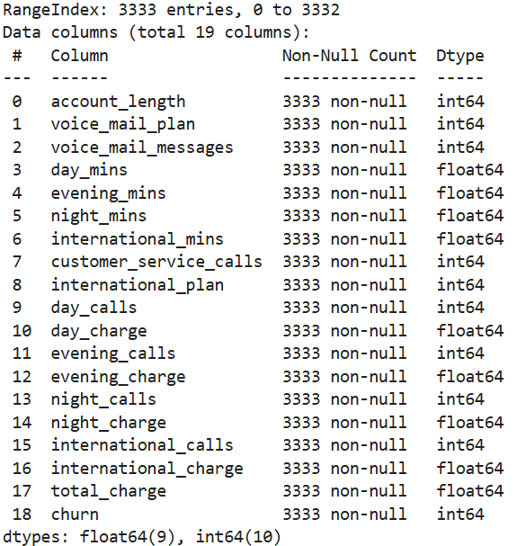
Dataset details:
It displays the summary of a telecom dataset, showing column names, non-null counts, and data types for each feature.
It helps to quickly understand the attributes like account length, voice mail messages, call details, and their respective data types (int64, float64, object) for further data analysis or preprocessing steps

Slide 5
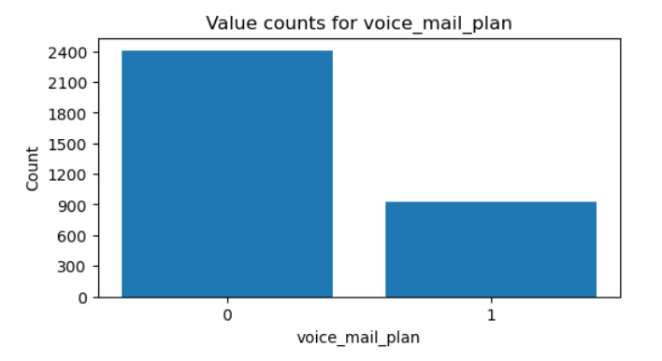
Performing Exploratory Data Analysis (EDA):
This bar chart representing the distribution of the 'voice_mail_plan' variable.
The chart helps visualize the count of customers with and without a voice mail plan. The count of 0’s - 2411 and 1’s - 922

Slide 6
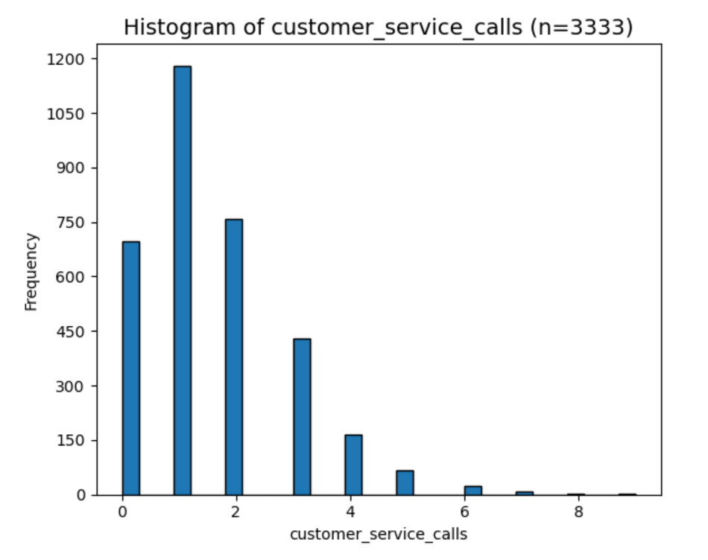
The majority of customers made between 0 and 2 service calls, while very few made higher numbers of calls, indicating a right-skewed distribution.

Slide 7
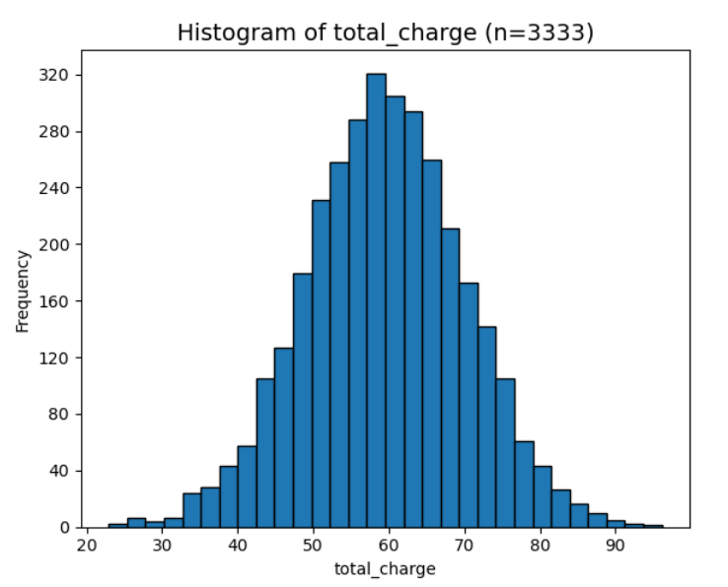
The distribution of total charges for 3,333 telecom customers, illustrating a near-normal pattern centered around the average charge.
This indicates that most customers are billed within a similar range, with fewer cases at both the high and low extremes.

Slide 8
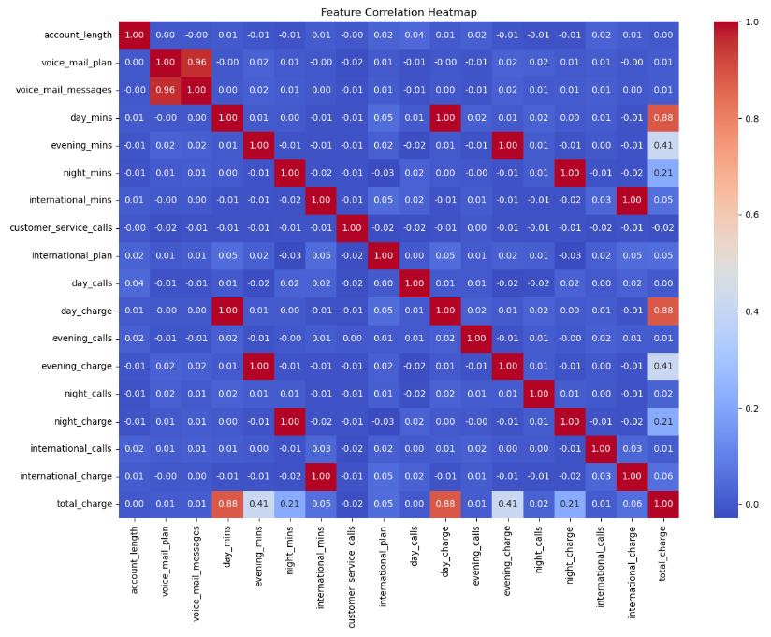
The heatmap visualizes correlations between multiple features, with blue indicating low correlation and red indicating high correlation.
Most feature pairs show low correlation, helping to reduce multicollinearity issues in modeling.
The visualization helps identify redundant variables and supports effective feature selection for improved model performance.

Slide 9
Feature engineering techniques and selection:
Methods Used:
Univariate Method:
Chi-squared test
F-classif
Recursive Feature Elimination (RFE)
Decision Tree Classifier (feature importance)

Slide 10
Selected Features:
Voice mail messages
Customer service calls
International plan
International charge
International calls
Day mins
Evening mins
Night mins
Total charge

Slide 11
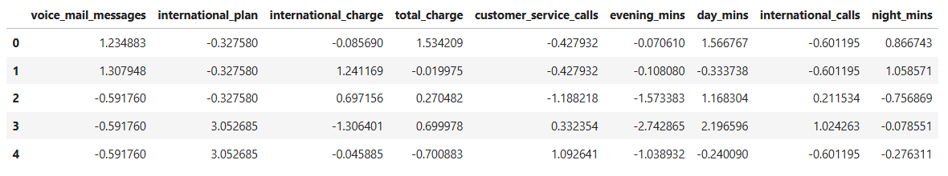
Upon selected features, they are standardized:
Selected features undergo standardization to ensure uniform scaling, removing bias from differing magnitudes.

Slide 12
Partition of data into Training and testing:
Data was divided into training and testing sets to evaluate model performance effectively.
Eighty percent of the data was used for training, while the remaining twenty percent was reserved for testing.
This split ensures a robust assessment of the model’s ability to generalize to unseen data.

Slide 13
Building different machine learning models:
The main Purpose is to train models to predict customer churn accurately.
Machine Learning Models:
Logistic Regression
Decision Tree
Random Forest
Gradient Boosting
SVM
XGBoost (XGB)
LightGBM (LGBM)

Slide 14
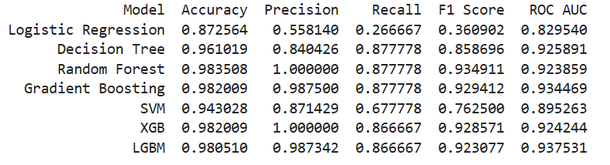
Model Performance Results:
Compared multiple ML models using accuracy, precision, recall, F1-score, and ROC AUC. Ensemble models showed strong consistency and reliability across all metrics. LightGBM proved to be the most effective model with the highest ROC AUC of 0.937.

Slide 15
The Best-performing model:
The model with the highest ROC AUC is considered the most reliable and consistent across different decision boundaries.
The LightGBM (LGBM) achieved the top ROC AUC score of 0.937, proving to be the most accurate and efficient model for this task.

Slide 16
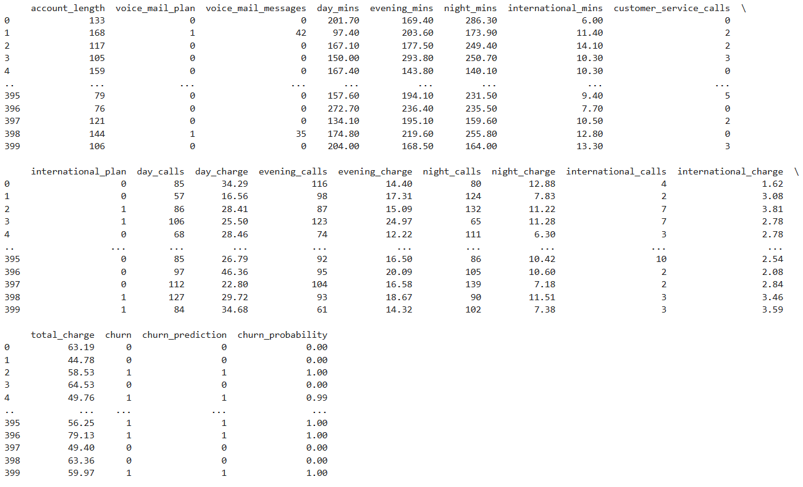
Model Testing:
The model was tested on unseen telecom customer data to evaluate its prediction accuracy.
The dataset includes key features such as call duration, charges (day, evening, night, international), and customer service calls.
Testing ensures the model’s ability to generalize beyond the training data and make accurate predictions.

Slide 17
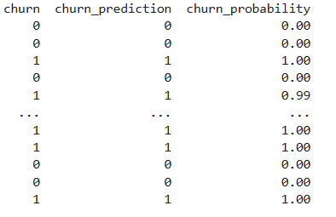
This showcases the process and results of model testing, specifically demonstrating how the model predicts outcomes (such as a "churn_prediction")
and provides associated
probabilities for each
sample.

Slide 18
Final Model Training on Complete Dataset:
After partitioning the dataset into 80% training and 20% testing, multiple machine learning algorithms were developed and evaluated. Among all the models tested, the Light Gradient Boosting Machine (LightGBM) classifier achieved the best performance.
To enhance the model’s predictive capability, the LightGBM model was retrained using the complete dataset (100%), allowing it to learn from all available data and improve its overall stability and accuracy.

Slide 19
Preparing for deployment:
Developed an interactive Streamlit web app for real-time churn prediction
Imported saved model and scaler with Joblib for efficient deployment. Accepted user input for 9 telecom features.
Converted categorical input (International Plan) to numeric format. Scaled input data using pre-trained scaler to maintain model consistency. Predicted churn probability and displayed result.
Predicted customer churn probability in real time. Displayed prediction output and Included probability score for better interpretability.

Slide 20
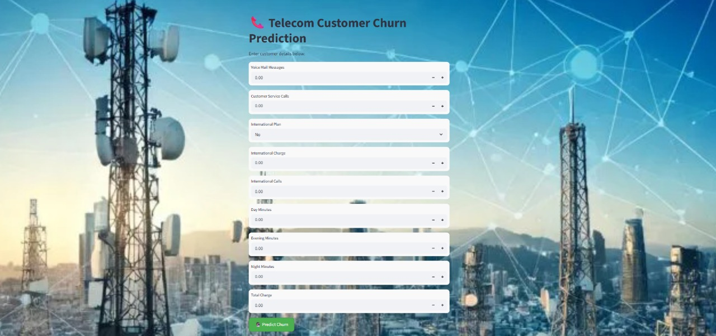
SCREEN SHOT OF THE APP PAGE:

Slide 21
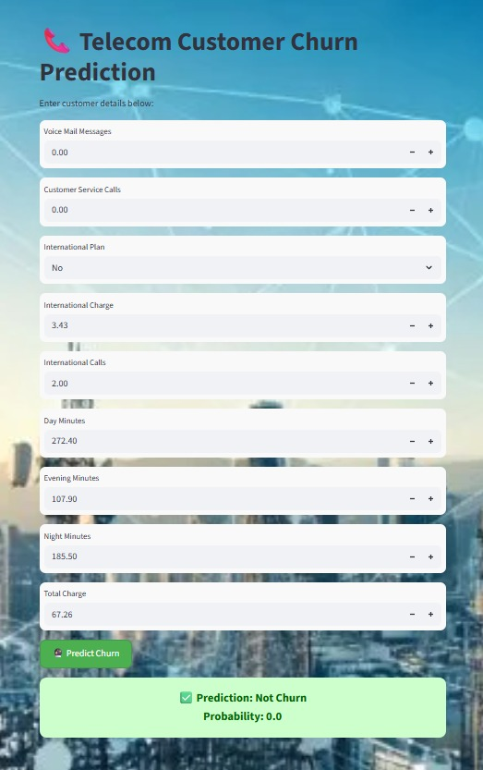
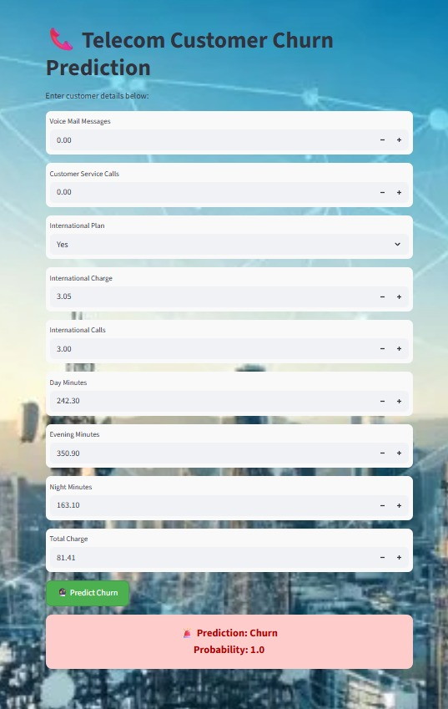

Slide 22
Strategic Recommendations to Reduce Telecom Customer Churn
Target High-Risk Customers with Retention Offers.
Improve Network Quality and Service Reliability.
Enhance Customer Support and Engagement.
Personalize Plans Based on Usage Patterns.
Monitor and Act on Feedback Continuously.

Slide 23
Challenges faced during the project:
Understanding Business Context – It took time to understand how telecom operations and customer behaviors impact churn.
Feature Selection – Identifying which features are truly affected customer churn was challenging.
Imbalanced Data – The number of not-churned customers were much lower than churned, which affected model training and evaluation

Slide 24
THANK YOU

